Slide 1



230 Yuma Street
Denver, CO 80223
(800) 582-4524
sales@xpcc.com
www.xpcc.com

Slide 2
XPC TX90/T90 6kVA and 10kVA Training Agenda
Features and Benefits
Options
Design and Operation
Installation
Front Panel
System Operation
Troubleshooting

Slide 3
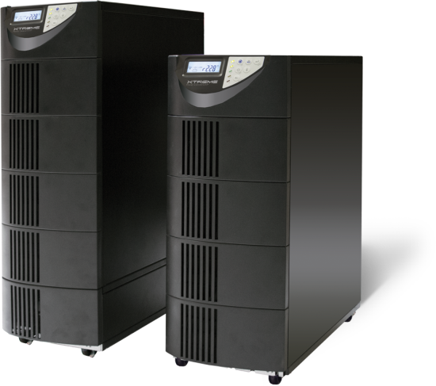
TX90 / T90 Features and Benefits
Product snapshot
Online scalable UPS for high power and critical N+1 redundant applications
TX90 6kVA & 10kVA // Isolated Online Tower UPS 240/120VAC or 208/120VAC
T90 6kVA & 10kVA // Online Tower UPS 208VAC or 230VAC
Single module configurations: 6kVA/5.4kW and 10kVA/9kW
Parallel capacity configurations: 12kVA/10.8kW to 40kVA/36kW
Parallel redundant (N+1) configurations: 6kVA/5.4kW to 30kVA/27kW
UL, cUL, CE, FCC, RoHS
3 years electronics, 3 years battery warranty (USA)
Features
0.9 output power factor
Frequency converter
Parallel operation
Galvanic isolation transformer (TX90)
Hot swappable battery trays
Maintenance bypass
Extended battery runtimes
Lockable casters

Slide 4
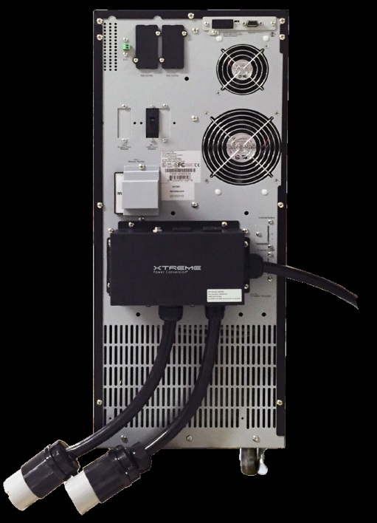
TX90 / T90 Available Options
Voltage Options
TX90 Standard Voltage: 208VAC input, 240 VAC Output
Voltages Available: 240V:240/120V, 230V:230/115V, 220V:220/110V, 200V:200/100V
Factory Voltage Change Ordered as T9VCNFG
Can be reconfigured in field
208:208/120 Not used due to output phases being 120VAC + 88VAC
T90 Standard Voltage: 208 VAC Input, 208 VAC Output
Optional voltages of 200/220/230/240VAC field selectable (firmware)
No 120 Volt out

Slide 5
TX90 / T90 Available Options
I/O Configuration Options
Hardwired input and output standard
L6-30 Line Cord available for 6KVA
Configurable Output Receptacles Available
I/O Box 1-5
XPD PDUs can provide additional outlets
I/O Box | Voltage | Recepts 1 | Recepts 2
I/O Box 1 | 240/120 | (2) C19 – 240V | (4) 5-15/20
I/O Box 2 | 120 | (2) C19 – 120V | (4) 5-15/20
I/O Box 3 | 240/120 | (2) L14-30 on 1 ft cord | (4) 5-15/20
I/O Box 4 | 240 | (2) L6-30 on 1 ft cord | (2) C19
I/O Box 5 | 208/120 | (2) C19 – 208V | (4) 5-15/20

Slide 6
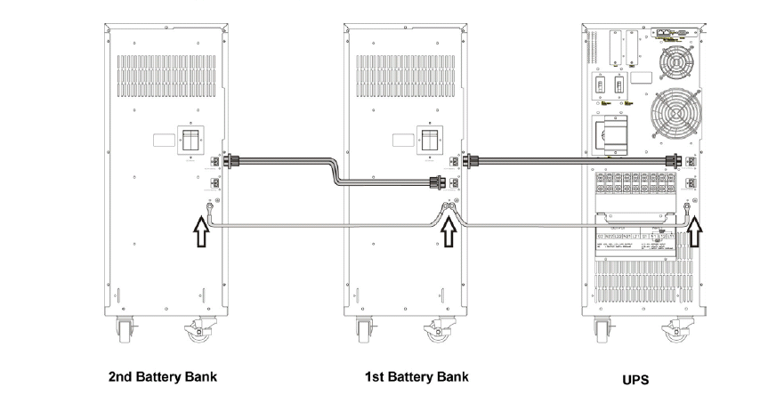
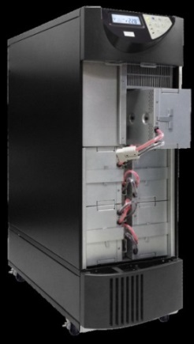
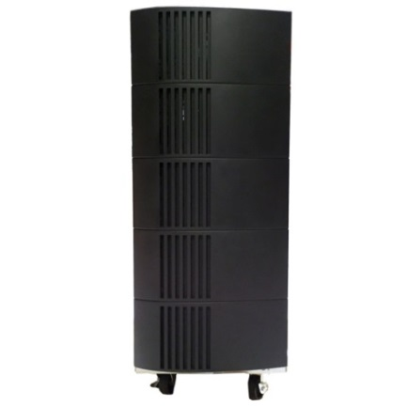
TX90 / T90 Available Options
Battery Options
TX90 and T90 Standard Internal Battery – 20 x 12V 9AH (10k) or 20 x 12V 7AH (6k) battery
Located in hot swappable trays
Extended Internal Runtime Available for TX90 – 20 x 12V 580W battery
Replaces standard battery
External Battery Cabinet Available – 20, 40, or 60 x 12V 9AH
External cabinet can accommodate 1, 2 , or 3 strings
Can be daisy chained for longer runtimes
1000W External Battery Charger Available

Slide 7
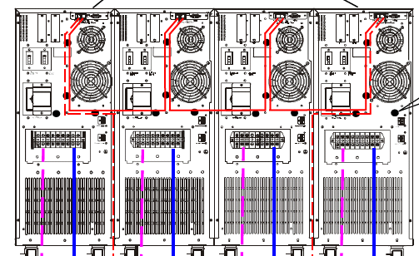
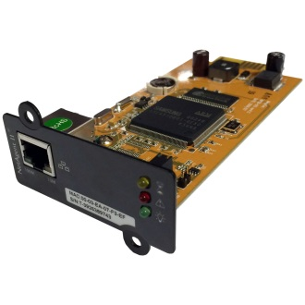
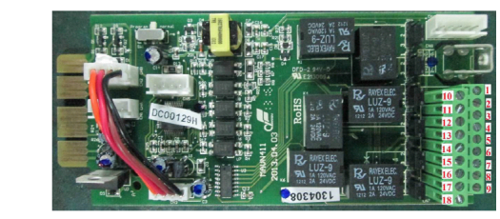
TX90 / T90 Available Options
Communication Options
SNMP Card
SNMP-1PIN
Relay Dry Contact Interface Card
TX90-Relay
6 Output Relay Contacts
Rated at 120VAC, 1A and 24VDC, 2A
3 Input Contacts
Parallel Kit
TX90-PK
Communication cables to parallel systems

Slide 8
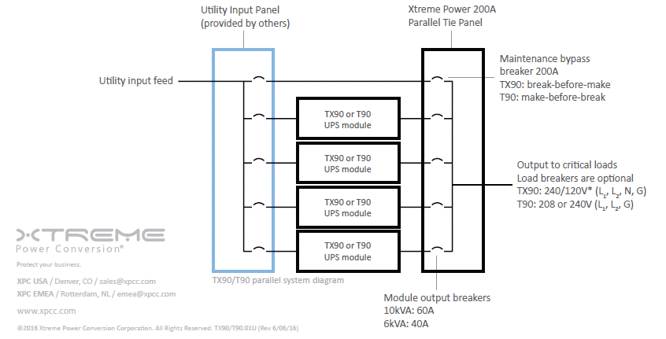
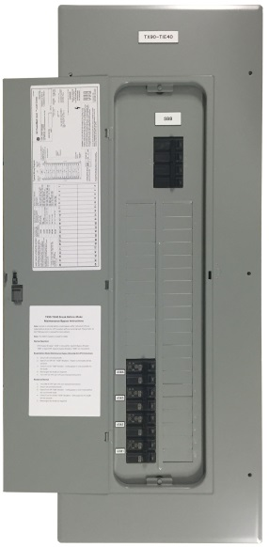
TX90 / T90 Available Options
Parallel Scalable Options
Can Parallel up to 4 systems
Parallel for Capacity or Redundancy
TX90-10k40 to TX90-40k40
TX90-6k24 to TX90-24k24
Parallel Systems include:
1-4 UPS systems with batteries
Tie-Cabinet for output
Includes System Bypass Breaker
Parallel cable kit for communication
Factory Startup – 5 x 8

Slide 9
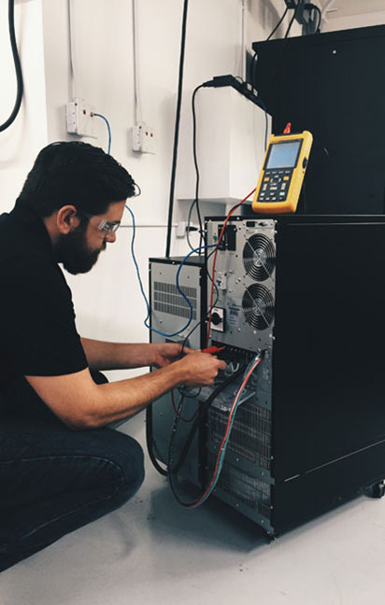
TX90 / T90 Available Options
Warranty and Service Options
Standard Warranty – 3 Year on Electronics and Battery
Extended 5 Year Warranty plans available on UPS and external battery
5 x 8 On-Site Service Plans
3 Year plans for UPS and external battery
5 Year plans for UPS and external battery
5 x 8 Startup available
5 x 8 Startup included with parallel system packages
7 x 24 Startup quoted by request
One time Preventative Maintenance available

Slide 10
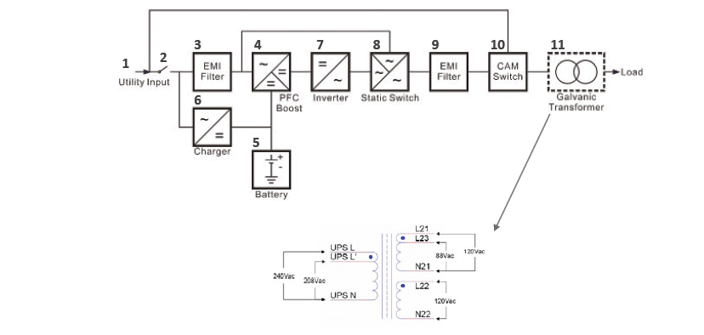
TX90 / T90 Design and Operation
TX90 One-Line
UPS Utility Input
UPS Utility Input Breaker
EMI Filter on UPS Utility Input
Rectifier and Booster
Internal Battery
Charger
Inverter
Auto Bypass Loop (Static Bypass)
UPS Output EMI Filter
Maintenance Bypass Switch
Output isolation transformer with adjustable input taps.

Slide 11
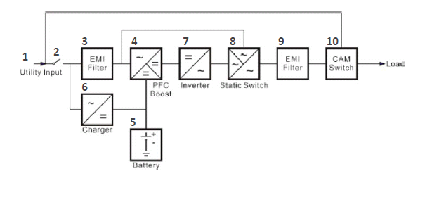
TX90 / T90 Design and Operation
T90 One-Line

Slide 12
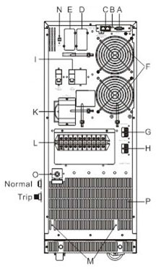
TX90 / T90 Design and Operation
TX90 Rear Panel
A. RS-232 Port
B. Terminal Resistor for Parallel function
C. CAN Bus Connection Port for Parallel System
D. Optional Communication Slot 1
E. Optional Communication Slot 2
F. Cooling Fans
G. External Battery Connector
H. External Charger Connector
I. Utility Input Breaker CB1
K. CAM Switch (Maintenance Bypass Switch)
L. Input/Output Terminal Block (shown with cover removed)
M. Mounting Holes for External Charger Cabinet
N. EPO (Emergency Power Off): Short to enable the function
O. Thermal breaker for the protection of Load in abnormal
condition: CB3 (TX90-10K only)
P. Air Ventilation Hole

Slide 13
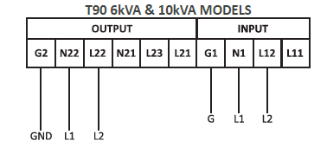
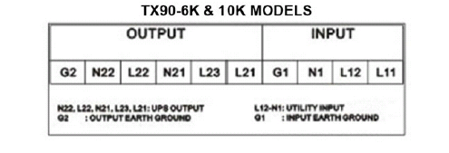
TX90 / T90 Installation
Terminal Block Explanation
T90 Terminal Block – 208 or 240 Input and Output
UPS Programming determines voltages
TX90 Terminal Block – 208 or 240 Input and 240/120 Output
Transformer configuration and UPS programming determines voltages

Slide 14
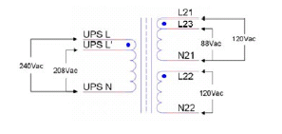
TX90 / T90 Installation
TX90 Transformer Windings
208 and 240 Volt Input Taps
208 Default
Can be Factory or Field Configured for 240
Dual Windings on Output
Voltage Required determines Configuration

Slide 15
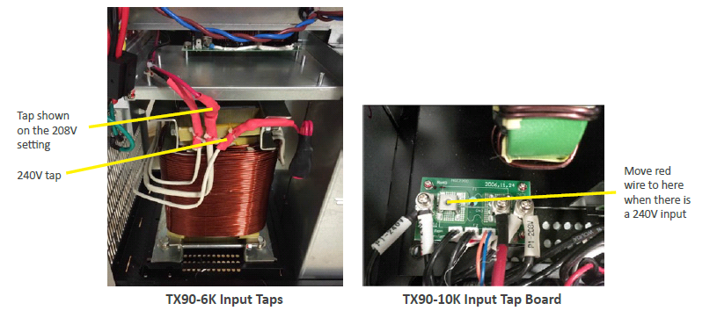
TX90 / T90 Installation
TX90 Transformer Input Tap
208 Default
UPS Programmed for 208V Inverter Output
240 Optional
Reconfigure tap for 240V
UPS Programmed for 240V Inverter Output
Voltage change can be factory ordered

Slide 16
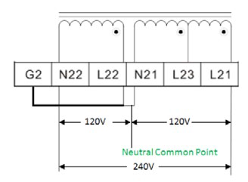
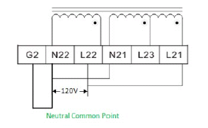
TX90 / T90 Installation
TX90 Transformer Output Connections
240/120 VAC Default
208/120 typically not recommended
Jumpers are factory installed
120 VAC Full Capacity Optional
Must reconfigure the jumpers

Slide 17
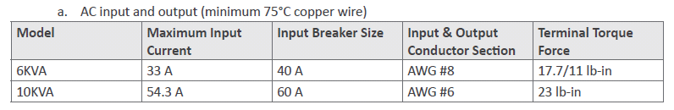
TX90 / T90 Installation
Breaker and Wiring

Slide 18
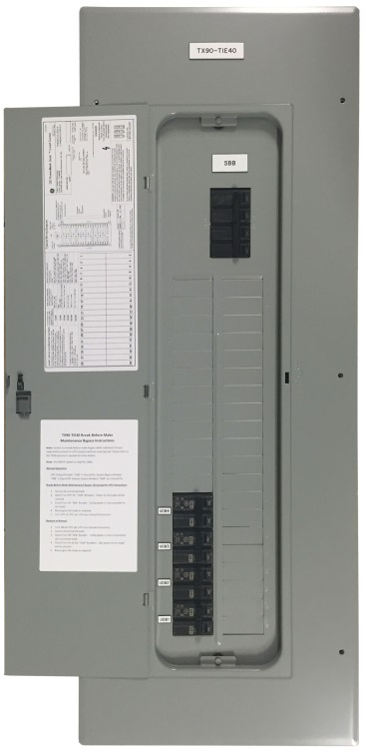
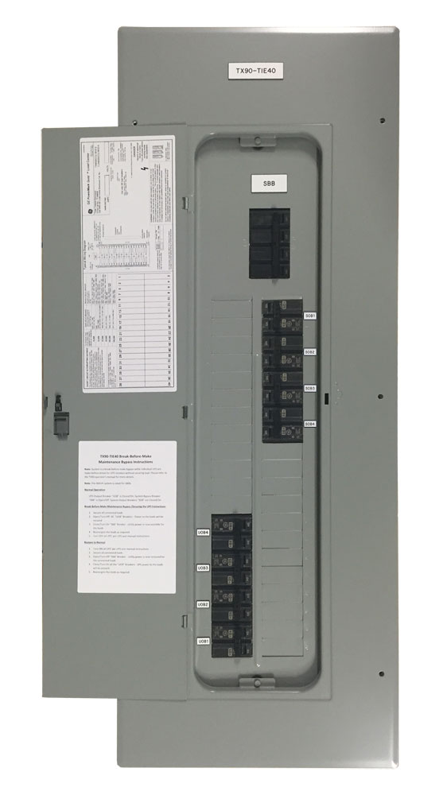
TX90 / T90 Installation
Parallel Tie Cabinet
Utilizes a GE Panelboard
UPS Output Breakers (UOB) for 4 Systems
Breakers are 40A for 6kVA or 60A for 10kVA
Main Breaker used as System Bypass Breaker (SSB)
Unused breaker locations can be used for System Output Breaker (SOB) or distribution breakers

Slide 19
TX90 / T90 Installation
Parallel Installation

Slide 20
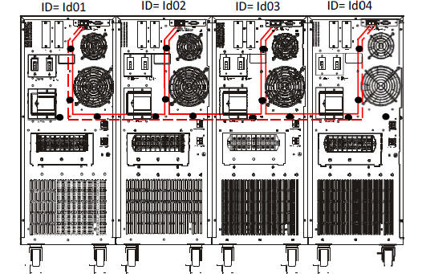
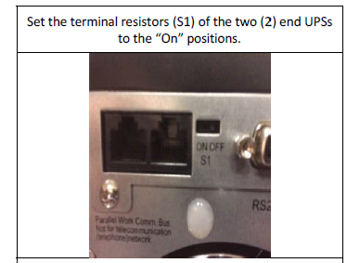
TX90 / T90 Installation
Parallel Communications
Parallel communications set up as a token ring
Enable parallel operation
Each UPS programmed with a unique ID
Terminal Resistors of two end UPSs set to On

Slide 21
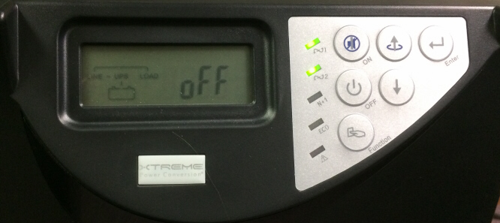
TX90 / T90 Front Panel
Front Panel Includes:
LCD
LEDs
S1 - Solid green LED - utility input voltage normal.
Flashing green LED - utility input voltage abnormal.
S2 - Green LED indicates that Bypass Input is normal.
N+1 - Green LED indicates that the UPS is able
to run under redundancy mode.
ECO - UPS is working under ECO mode.
UPS Fault or Abnormal
BUTTONS
On - UPS ON/Alarm Silence
Go to previous page or change the settings
Enter - Confirm a changed setting.
Go to the next page.
Off - UPS OFF Switch
Functions - Special functions log in/out

Slide 22
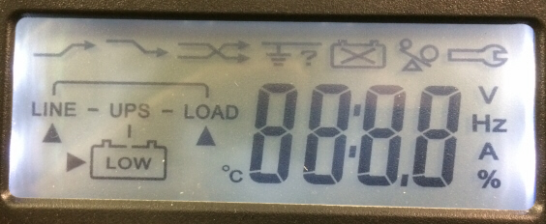
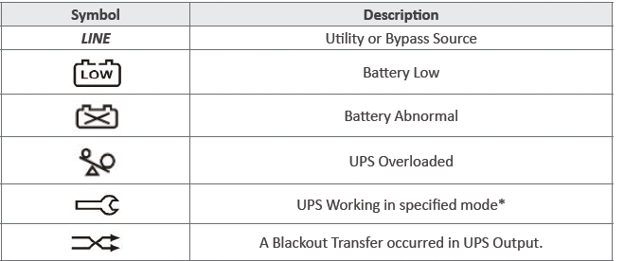
TX90 / T90 Front Panel
Symbols on LCD

Slide 23
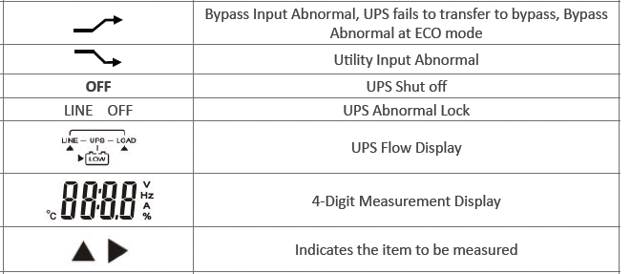
TX90 / T90 Front Panel
Symbols on LCD

Slide 24
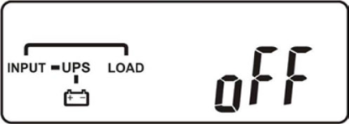
TX90 / T90 System Operation
System Start Up
Verify Installation
Clearances
Environment
Voltages
Breaker and Wiring Sizes
Connections
Verify that utility voltage and output voltage desired match UPS configuration
Verify that output breakers, if installed, are off
Turn on AC Input
UPS will go to bypass and start a self test
UPS is providing output power via static bypass and charging battery

Slide 25
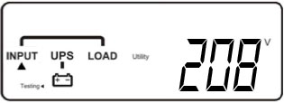
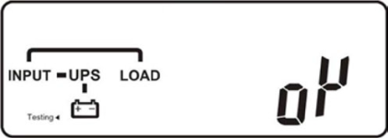
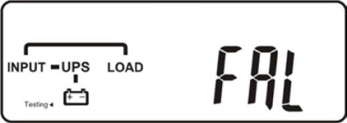
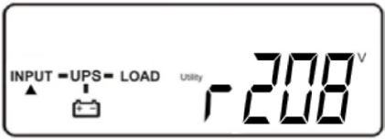
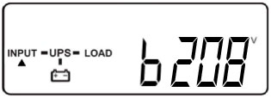
TX90 / T90 System Operation
System Start Up
Press the “ON” Button for 3 seconds
UPS will beep twice and start another self test
UPS will indicate test pass or fail
If test pass, UPS will go into on line mode
You can press the down arrow to step through displayed values

Slide 26
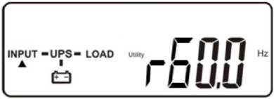
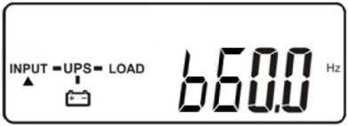
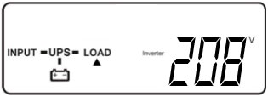
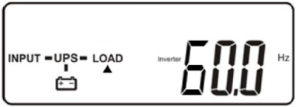
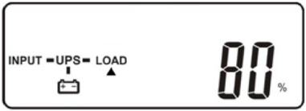
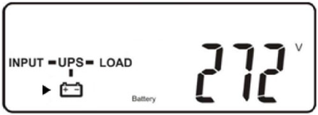
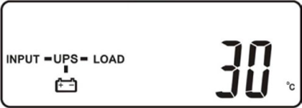
TX90 / T90 System Operation
Viewing Monitored Values
Press the down and up arrows to step through displayed values
Bypass Input Voltage
Utility Input Frequency
Bypass Input Frequency
Inverter Output Voltage
Output Frequency
% Load
Battery Voltage
UPS Internal Temperature

Slide 27


TX90 / T90 System Operation
Viewing or Programming Function Settings
Press the “Function” Button to view settings
Buzzer and Self-Test can be toggled by pressing Up Arrow
Press Down Arrow to step to next function
Press ON and Down Arrow for 3 seconds to enter Function Programming Mode
UPS must be in Off Mode to change functions other than Buzzer and Self-Test
Function setting can be toggled to other settings by pressing Up Arrow
Press Down Arrow to step to next function
Press Enter Button at SAVE screen
UPS will Lock and must be restarted
Functions
Buzzer
On or Off
Self-Test
On or Off

Slide 28

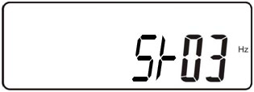


TX90 / T90 System Operation
Viewing or Changing Function Settings
Bypass Voltage
S_Lo - 184-260 VAC
S_Hi - 195-260 VAC
Frequency Window
±3 Hz or ±1 Hz
Inverter Output Voltage
200, 208, 220, 230, or 240 VAC
Must be the same as Input Voltage
Operating Mode
Normal, ECO, CF50, or CF60

Slide 29





TX90 / T90 System Operation
Viewing or Changing Function Settings
Output Voltage Adjustment
-1, -2, -3, 0, 1, 2, 3%
UPS Position in Parallel Mode
Id01 through Id04
Parallel Function
Po1 – Off
Po2 - On
Save
Press Enter
UPS is Locked
Restart UPS

Slide 30
TX90 / T90 System Trouble Shooting
Error Codes issued by UPS
Er01 1st stage DC BUS capacitor pre-charge abnormal after 50 seconds or Battery Fuse fails
Er02 AC SCR or Battery SCR soft Start abnormal after 2 seconds
Er03 3rd PFC(Boost) soft start abnormal after 30 seconds
Er04 Inverter out of order
Er05 Battery Weak or Dead
Er06 Output Short Circuit
EPO EPO Mode
Er08 DC Bus high-voltage-level abnormal
Er09 DC Bus low-voltage-level abnormal
Er10 Inverter Over-current
Er11 UPS Overheat
Er12 Inverter Overload

Slide 31
TX90 / T90 System Trouble Shooting
Error Codes issued by UPS
Er13 Charger out of order or abnormal
Er14 Fan out of order
Er15 Wrong Procedure to Enter Maintenance Mode
Er16 Output Parameters Set Error in Parallel System
Er17 ID Numbers are in conflict in Parallel System or ID number Error in single unit
Er18 EEPROM’s data error. Its values are reset to default.
Er19 Reserved
Er20 DC Bus voltage can’t be discharged
Er21 Parallel communication error
(communication wire disconnected or failure to find ID1 UPS) in parallel system
Er22 Bypass SCR or Output Fuse Fails
Er23 Inverter Relay or SCR or Output Fuse Fails

Slide 32
TX90 / T90 System Trouble Shooting
Error Codes issued by UPS
Er24 Bypass Input found when Running on CVCF mode
Er25 Reserved
Er26 PFC over-current
Er27 The UPS must be operated in normal mode in parallel system
Er28 Bypass Overload Time out and cut off output.
Er29 Charger Overcharges battery (>300Vdc)
Er30 Inverter Balance Error
Er31 The settings of both control board and driver board are not matched each other.
Er32 Sync Signal Error
Er33 Isolated transformer overheat
Er34 Balance function conflict

Slide 33
TX90 / T90 System Trouble Shooting
Error Codes issued by UPS
CEr1 Utility voltage out of range
CEr2 Bypass Voltage out of range
CEr3 Inverter Voltage out of range
CEr4 Load Percentage out of range
CEr5 Battery Voltage out of range
CEr6 UPS Output Voltage out of range

Slide 34
TX90 / T90 System Trouble Shooting
Special Remarks on Error Codes
When one of the Er06, EPO, Er23, Er24, Er28, Er32 ,or Er33 error message occurs, the UPS will have no output and lock itself immediately.
If the bypass voltage is normal(within specs), but one of the Er01, Er02, Er03, Er05, Er13, Er14, Er20, Er22, Er26, Er29 or Er30 error message occur, the UPS will transfer to Bypass loop and lock itself.
If the bypass voltage is normal(within specs), one of the Er04, Er08, Er09, Er10, Er11 or Er12 error message occurs, the UPS will transfer to Bypass loop, then try to transfer back to Inverter mode automatically. If the symptoms happen 4 times in one hour, the UPS will lock itself; otherwise, the error messages and the times of the error messages will be clear and reset automatically.
If the Er16, Er17, Er21, Er27, Er31 or Er34 error message occurs, the inverter of the UPS will have no output and the user is prohibited to turn on the UPS from the front panel.

Slide 35
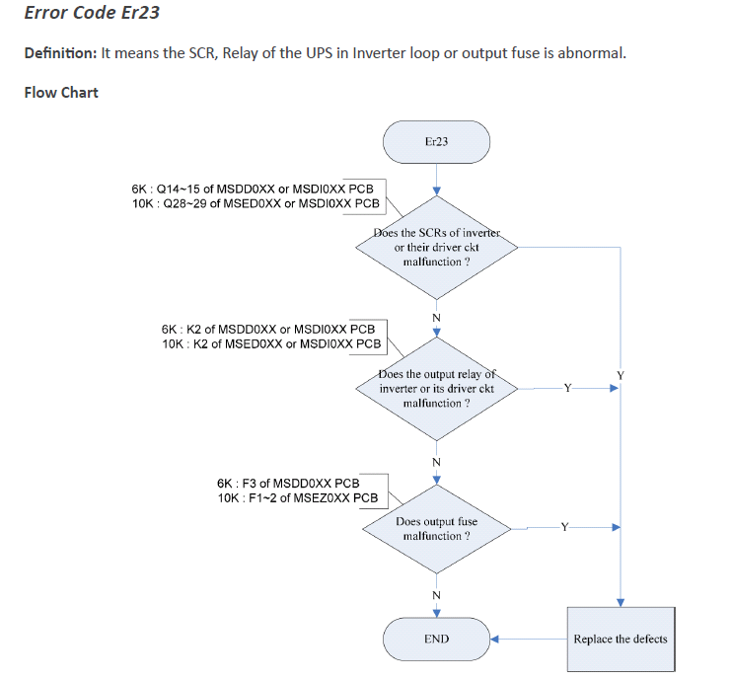
TX90 / T90 System Trouble Shooting
Trouble Shooting Error Codes
XPC TX90 6kVA & 10kVA Service Manual contains flow charts for each error code

Slide 36
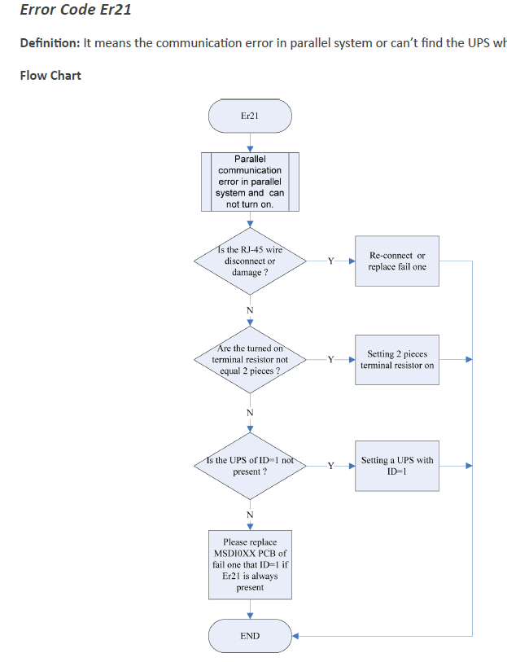
TX90 / T90 System Trouble Shooting
Trouble Shooting Error Codes

Slide 37
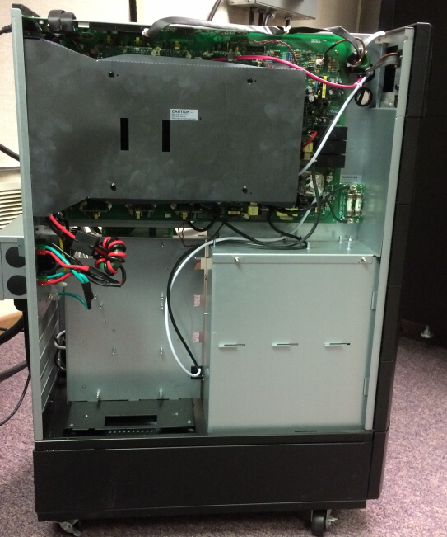
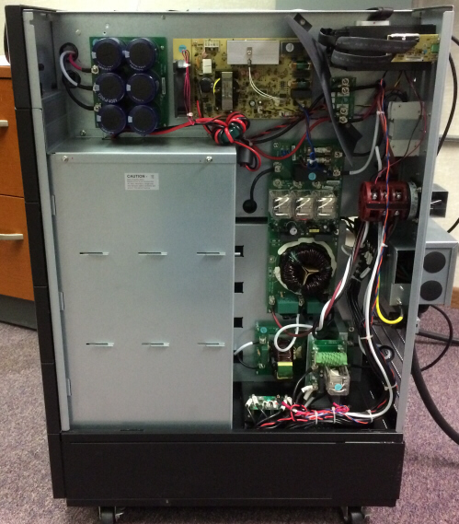
TX90 / T90 System Trouble Shooting
PCB Locations
Control Board
Power Board
Fuse
DC Capacitor Board
Battery Charger Board
EPO
I/P EMI Filter Power
Cam Switch
O/P EMI Filter Board
Relay
Voltage Change Board
Battery

Slide 38
Thank you, Questions?
Xtreme Power Conversion
230 Yuma Street
Denver, CO 80223
800.582.4524
Sales & Customer Support 1-800-582-4524 ext 1 sales@xpcc.com
Technical Support & Service 1-800-582-4524 ext 2 support@xpcc.com service@xpcc.com
Marketing marketing@xpcc.com

